Slide 1
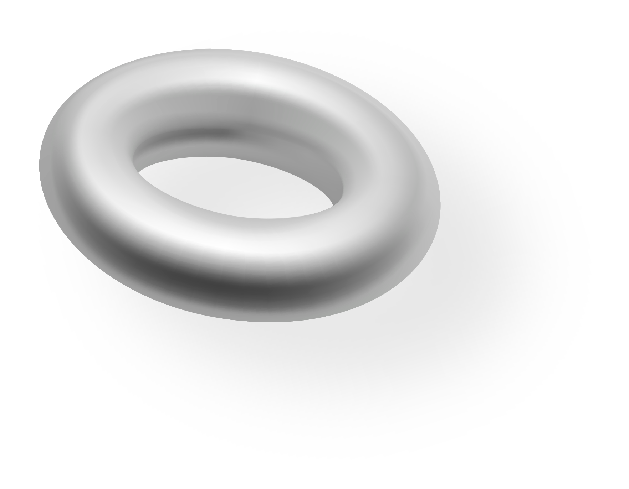


3D DESIGN STYLE SOCIAL MEDIA STRATEGY
Here is where your presentation begins

Slide 2
CONTENTS OF THIS TEMPLATE
You can delete this slide when you’re done editing the presentation
Fonts | To view this template correctly in PowerPoint, download and install the fonts we used
Used and alternative resources | An assortment of graphic resources that are suitable for use in this presentation
Thanks slide | You must keep it so that proper credits for our design are given
Colors | All the colors used in this presentation
Icons and infographic resources | These can be used in the template, and their size and color can be edited
Editable presentation theme | You can edit the master slides easily. For more info, click here
For more info:
SLIDESGO | BLOG | FAQS
You can visit our sister projects:
FREEPIK | FLATICON | STORYSET | WEPIK | VIDEVO

Slide 3
TABLE OF CONTENTS
01
04
02
05
03
06
Goals and objectives
Platforms and scheduling
Target audience demographics
Measurement and evaluation
Content ideation
Budgeting and planning

Slide 4
WHY SHOULD YOU DESIGN A SOCIAL MEDIA STRATEGY?
Having a social media strategy will help you plan and implement effective social media campaigns, allowing you to reach your desired audience with the right content. A good strategy will help you:
Coordinate your communications through different forms of media
Maximize exposure and engagement with your target audience
Keep track of your progress more easily and identify areas
for improvement

Slide 5
01
GOALS AND OBJECTIVES

Slide 6
THE PILLARS OF SOCIAL MEDIA STRATEGIES
Content ideation
Platform selection
Content ideation involves brainstorming ideas for content that will engage your target audience. This could include thought-provoking questions, polls, surveys, stories and discussions. It is important to consider the interests of your target audience and new trends
Careful platform selection is essential for successfully reaching your target audience. Additionally, you should analyze which platforms are most popular with your desired demographic and tailor your strategy to reach them more effectively. Keep up to date as there might be new trends that affect engagement

Slide 7
THREE GOALS OF A SOCIAL MEDIA STRATEGY
More reach
Engagement
Conversions
To increase reach, it is important to create content that resonates with your target audience and utilizes the most effective methods for reaching new viewers
Improving engagement involves creating content that encourages users to interact with your posts. Responding to comments in a timely manner is great way to show appreciation for their participation
Creating content that drives conversions entails promoting sales or generating leads for your business. This could include hosting giveaways, offering discounts or coupons to followers or targeted ads

Slide 8
FOUR TIPS
Be consistent
Use analytics tools
Developing a consistent content plan is essential for any successful social media strategy. Have a schedule of when to post content, optimize with keywords and keep track of it all
It can help you measure key metrics like visits, click-through rates, impressions, and conversions as well as understanding how your audience is engaging with your content
Advertise wisely
Establish brand loyalty
Advertising on social media channels can be a great way to reach a wider audience quickly and effectively. However, it is important to use targeted, specific ads
Establishing brand loyalty involves creating relationships with existing & potential customers through appreciation & thoughtfulness across all communication channels including social media platforms

Slide 9
SIX IDEAS FOR POSTS
Monday
Tuesday
Wednesday
A quote or thought provoking message which is related to your brand and
encourages engagement
Behind the scenes of your product/service. Share a photo or video of what goes into creating the item/service
Fun fact about your company or industry in order to engage followers with
something educational
Thursday
Friday
Saturday
Ask followers for their opinion by posing an interesting question or encourage user-generated content
Feature customer success stories to highlight how customers have benefited from using your product/service
Showcase upcoming events or promotions that are coming up so people know when to look out for them

Slide 10
123,123
Keep track of interactions with your posts

Slide 11



SOCIAL MEDIA IS ALL ABOUT PEOPLE

Slide 12
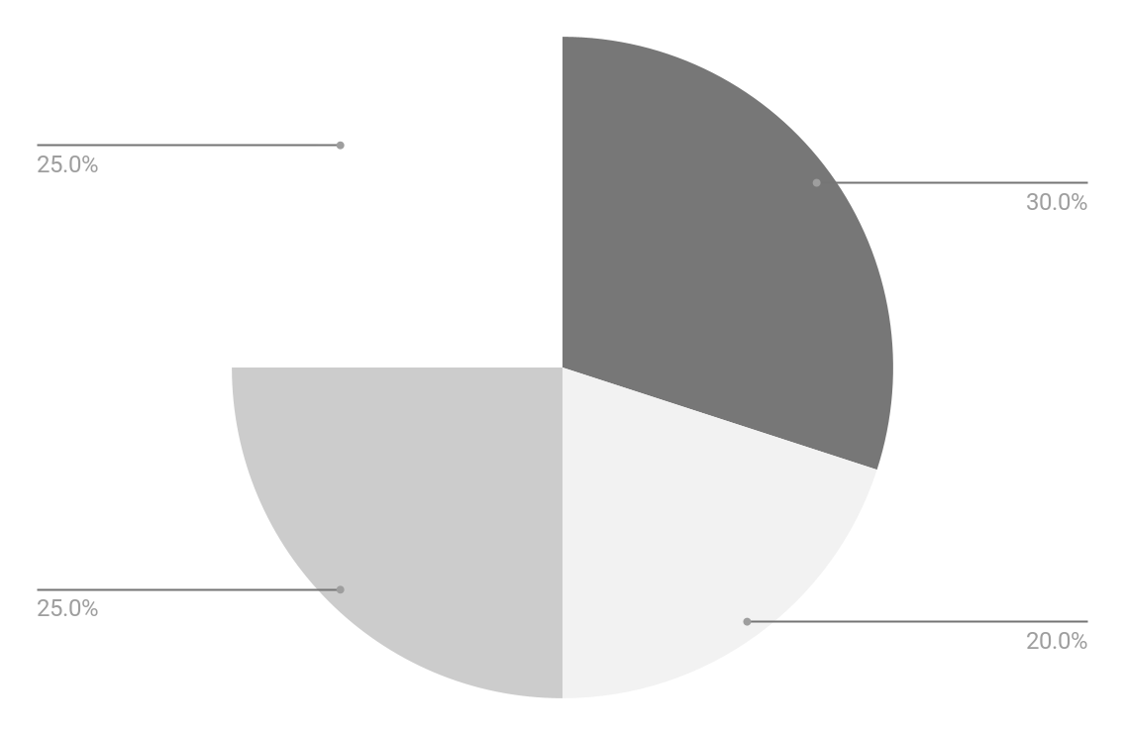
ENGAGEMENT SHARE
20%
Instagram
20%
TikTok
35%
Twitter
25%
Pinterest
Follow the link in the graph to modify its data and then paste the new one here. For more info, click here

Slide 13
A TABLE FOR YOUR SCHEDULES
 | Monday | Tuesday | Wednesday | Thursday | Friday
TikTok | OOTD | Dance trend | Q&A | A day with me! | Giveaway
Instagram | Story | Post | - | Reel | Story
Twitter | Answer FAQs | History thread | Fun facts | Quotes | -
Pinterest | Vision board | How it’s made | Inspirations | - | Tips
Email | - | Why premium? | - | Special event | Xx
Facebook | Our company | - | Product placement | Corporate video | -

Slide 14






THIS IS HOW YOUR PAGE WILL LOOK LIKE
1
Your username
2
Remember that web pages must be optimized to work on phones, since 80% of people only visit webs from their smartphones:
Your brand name should be the first thing they see
Put your best product on the front page
Your audience should have a way of engaging with your content
3

Slide 15

BUYER PERSONA INFOGRAPHIC
“I want to support the planet with each buy. That’s why I support companies that are eco-friendly”
Motivations
1
Self-improvement
Jane Doe
Personality
2
Organisation
26, Teacher
Strong ideas in favor of ecology, sustainability, recycling and upcycling
Avid user of social media, specifically TikTok and Twitter
Keeps up to date with trends and follows brands that do so
3
Ecology
Bio
Pain points
Our average client is outdoorsy, has creative jobs and a passion for the environment and the planet
Programmed obsolescence, difficulty repairing products and too much usage of unnecessary plastics

Slide 16
ROADMAP INFOGRAPHICS OF OUR MEDIA
Initiative | Objective | Jan | Feb | Mar | Apr | May | Jun | Jul | Aug | Sep | Oct | Nov | Dec
Dance trend | Make a video of our team following the newest trend on TikTok
A day in my life | Showing the most human side of our company
Anniversary giveaway | Generate engagement and get new followers
“How it’s made” reel | Show our creative process and engage new followers
Live on tikTok | Create a webinar to show new clients how to use our products
Instagram contest | Get more people to speak about us and use our hashtag “#company”

Slide 17


“A DAY WORKING WITH ME”
This trend shows the perks of your company and helps you establish brand identity

Slide 18



TESTIMONIALS OF PAST CLIENTS
“The team was great to work with! They provided fast and helpful service and their attention to detail was top-notch. Highly recommend!”
—Laura Patterson
“I had a fantastic experience working with them. They made the process easy and stress-free. I will definitely buy here again”
—John Nelson
“We had been searching for the right solution for our business for a long time, but the team found us the perfect fit!”
—Peter James

Slide 19
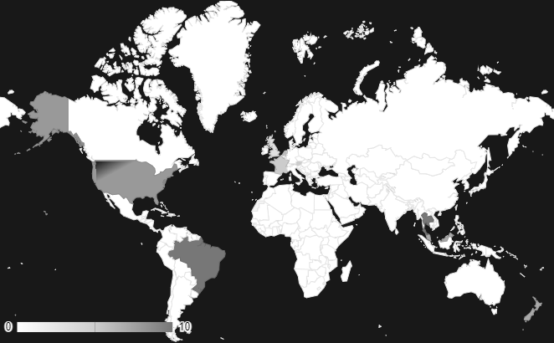
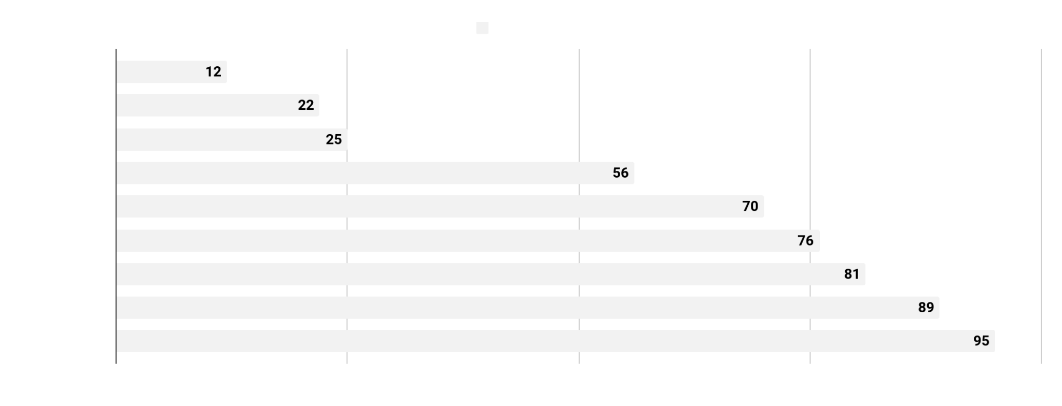
SOCIAL MEDIA ANALYTICS
Xxx billion
Xh xmin
Xx
Users worldwide
Average
time spent
Number of platforms used
Xxx billion
Xxx billion
Country 1 users
Country 2 users
Follow the link in the graph to modify its data and then paste the new one here. For more info, click here

Slide 20
THANKS!
Do you have any questions?
youremail@freepik.com
+91 620 421 838
yourcompany.com
Please keep this slide for attribution

Slide 21
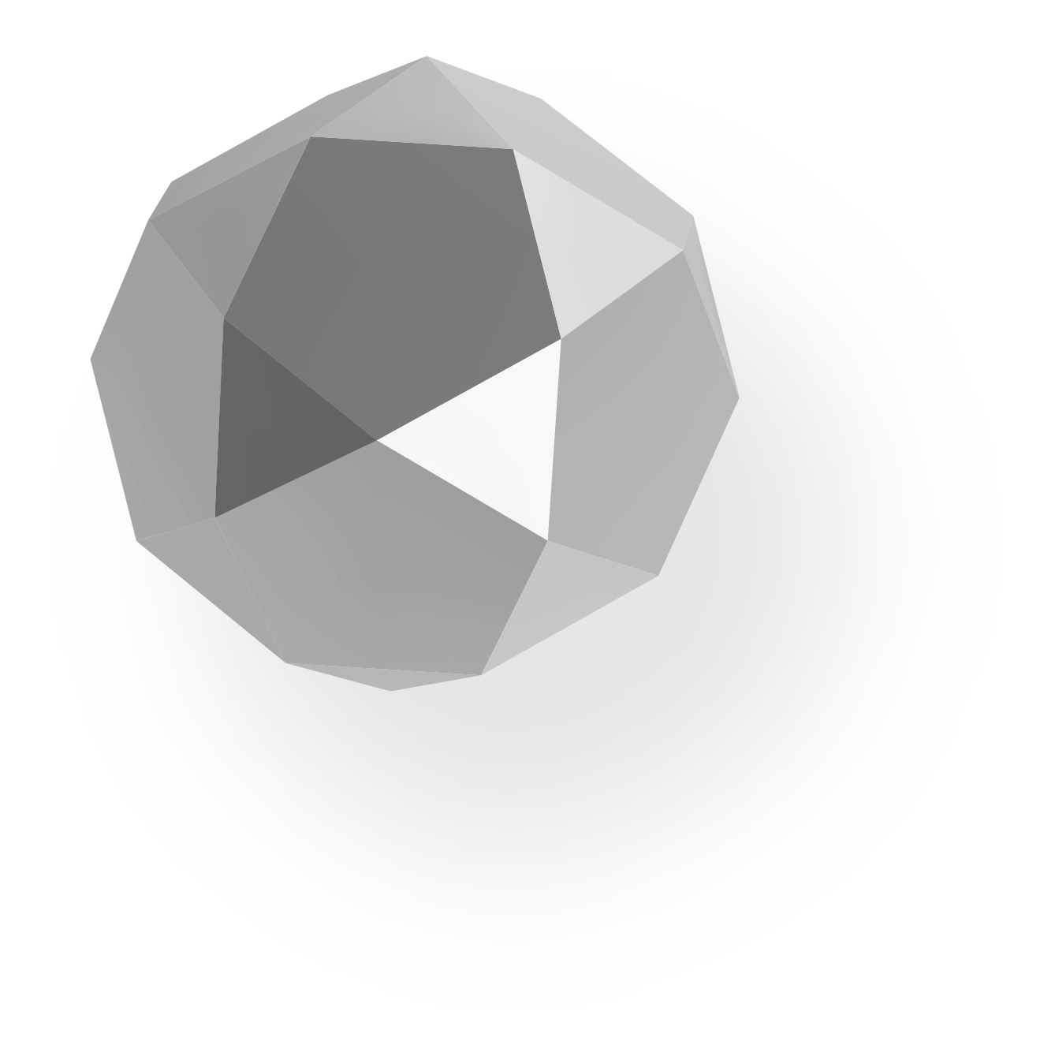



ALTERNATIVE RESOURCES
Here’s an assortment of alternative resources whose style fits the one of this template
Vectors
3d design banner template
3d design flyer template

Slide 22
RESOURCES
Did you like the resources on this template? Get them for free at our other websites:
Photos
Top view of minimalistic geometrical figures I
Top view of minimalistic geometrical figures II
Front view of geometrical figures
Still life of unused bath bombs
Medium shot smiley man posing with glasses
Front view woman wearing sunglasses
Handsome asian man posing
Side view smiley woman posing
3d rendered abstract design elements assortment
3d rendered abstract design elements arrangement
High angle of minimalistic geometrical figures with copy space
Abstract 3d design elements arrangement
Vectors
3d design landing page
3d design banner template I
3d design banner template II

Slide 23
Instructions for use
If you have a free account, in order to use this template, you must credit Slidesgo by keeping the Thanks slide. Please refer to the next slide to read the instructions for premium users.
As a Free user, you are allowed to:
Modify this template.
Use it for both personal and commercial projects.
You are not allowed to:
Sublicense, sell or rent any of Slidesgo Content (or a modified version of Slidesgo Content).
Distribute Slidesgo Content unless it has been expressly authorized by Slidesgo.
Include Slidesgo Content in an online or offline database or file.
Offer Slidesgo templates (or modified versions of Slidesgo templates) for download.
Acquire the copyright of Slidesgo Content.
For more information about editing slides, please read our FAQs or visit our blog:
https://slidesgo.com/faqs and https://slidesgo.com/slidesgo-school

Slide 24
Instructions for use (premium users)
As a Premium user, you can use this template without attributing Slidesgo or keeping the "Thanks" slide.
You are allowed to:
Modify this template.
Use it for both personal and commercial purposes.
Hide or delete the “Thanks” slide and the mention to Slidesgo in the credits.
Share this template in an editable format with people who are not part of your team.
You are not allowed to:
Sublicense, sell or rent this Slidesgo Template (or a modified version of this Slidesgo Template).
Distribute this Slidesgo Template (or a modified version of this Slidesgo Template) or include it in a database or in any other product or service that offers downloadable images, icons or presentations that may be subject to distribution or resale.
Use any of the elements that are part of this Slidesgo Template in an isolated and separated way from this Template.
Register any of the elements that are part of this template as a trademark or logo, or register it as a work in an intellectual property registry or similar.
For more information about editing slides, please read our FAQs or visit our blog:
https://slidesgo.com/faqs and https://slidesgo.com/slidesgo-school

Slide 25
Fonts & colors used
This presentation has been made using the following fonts:
Space Grotesk
(https://fonts.google.com/specimen/Space+Grotesk)
Maven Pro
(https://fonts.google.com/specimen/Maven+Pro)
#ffffff
#181818
#777777
#cccccc
#f2f2f2

Slide 26

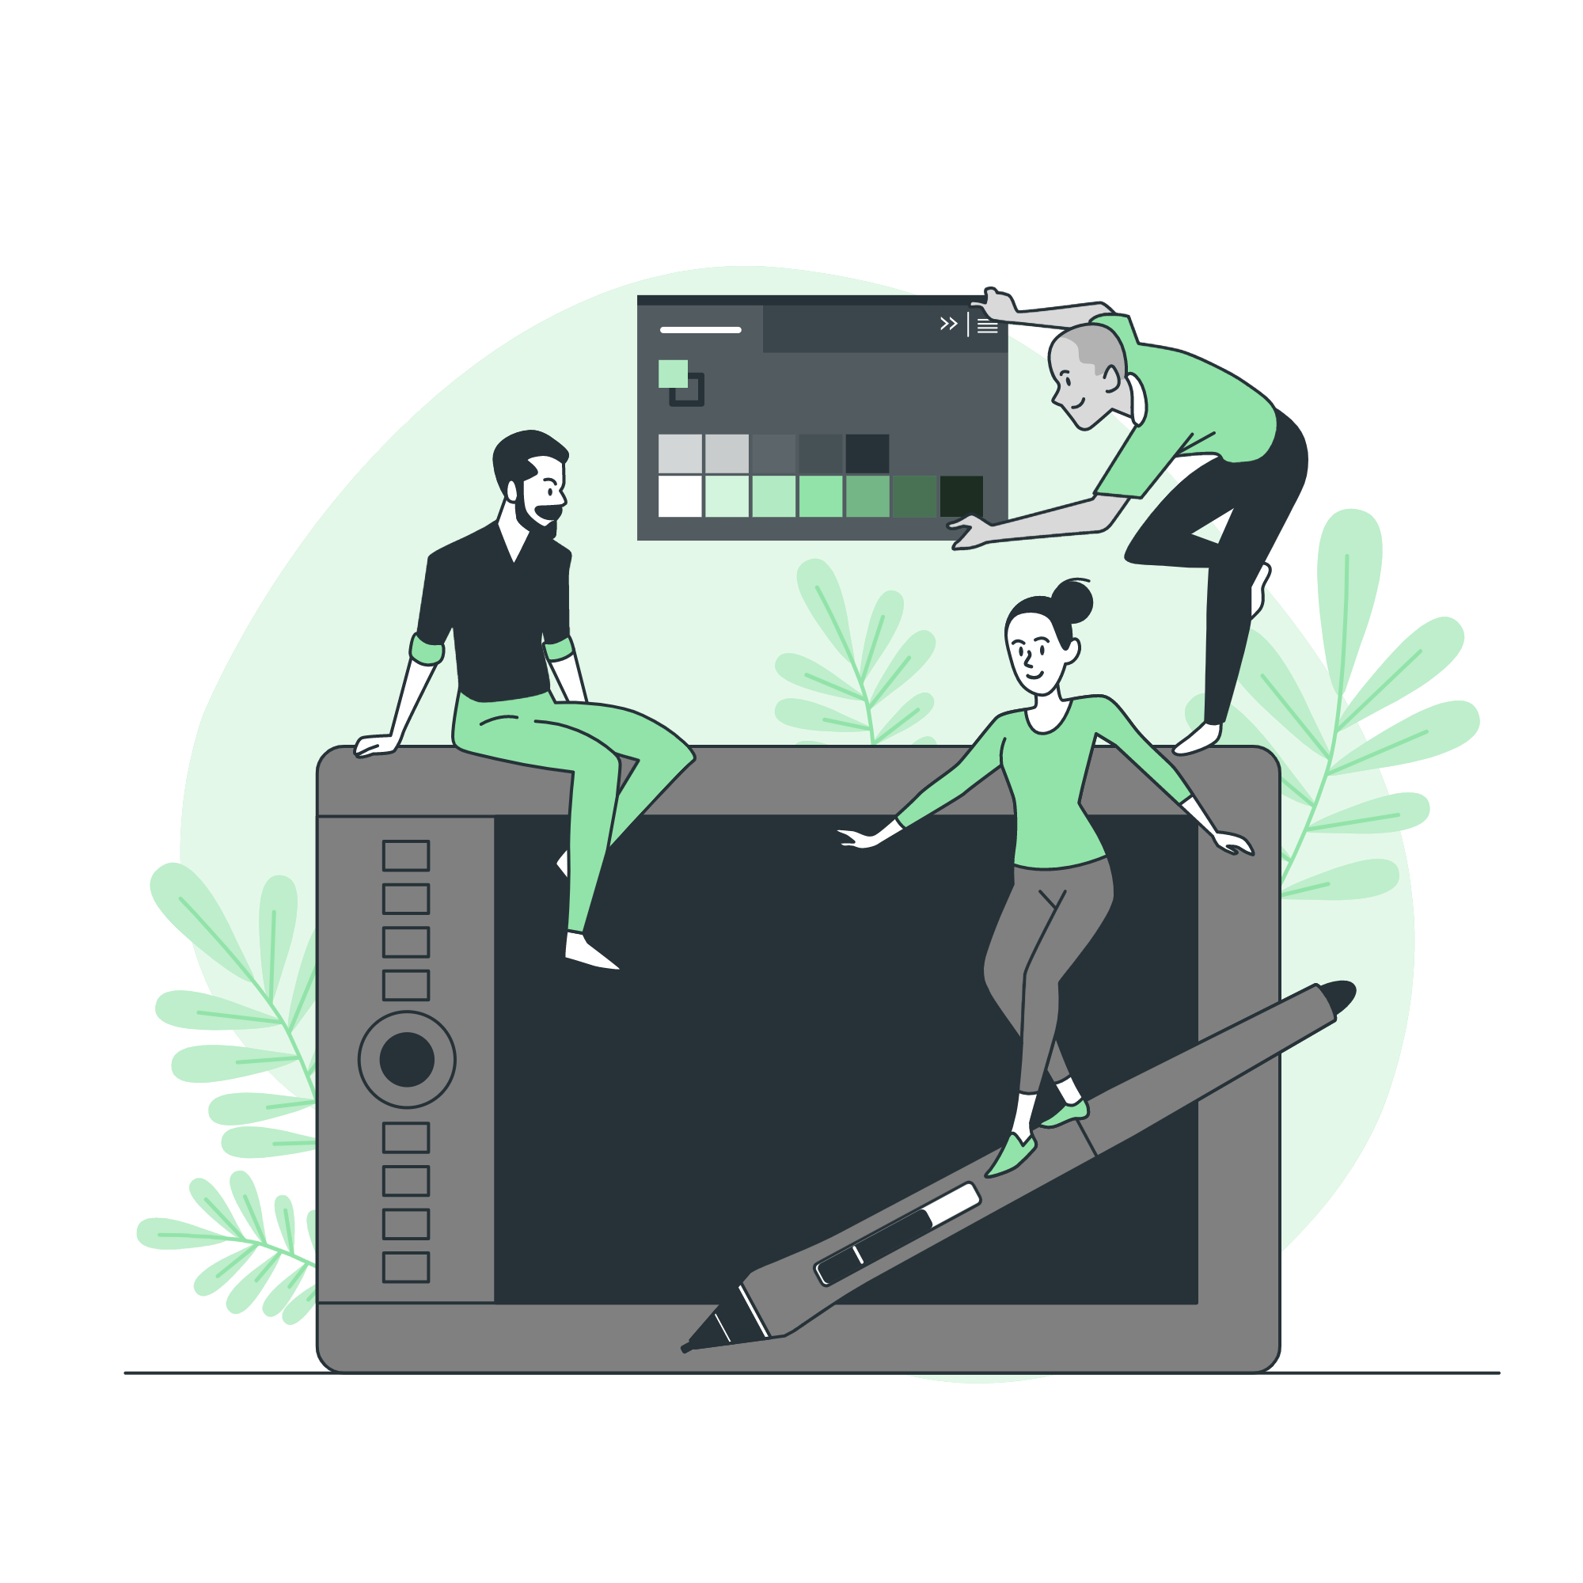



Storyset
Create your Story with our illustrated concepts. Choose the style you like the most, edit its colors, pick the background and layers you want to show and bring them to life with the animator panel! It will boost your presentation. Check out how it works.
Pana
Amico
Bro
Rafiki
Cuate

Slide 27
Use our editable graphic resources...
You can easily resize these resources without losing quality. To change the color, just ungroup the resource and click on the object you want to change. Then, click on the paint bucket and select the color you want. Group the resource again when you’re done. You can also look for more infographics on Slidesgo.

Slide 30
JANUARY
FEBRUARY
MARCH
APRIL
MAY
JUNE
PHASE 1
Task 1
Task 2
PHASE 2
Task 1
Task 2
JANUARY
FEBRUARY
MARCH
APRIL
PHASE 1
Task 1
Task 2

Slide 33
...and our sets of editable icons
You can resize these icons without losing quality.
You can change the stroke and fill color; just select the icon and click on the paint bucket/pen.
In Google Slides, you can also use Flaticon’s extension, allowing you to customize and add even more icons.

Slide 34
Educational Icons
Medical Icons

Slide 35
Business Icons
Teamwork Icons

Slide 36
Help & Support Icons
Avatar Icons

Slide 37
Creative Process Icons
Performing Arts Icons

Slide 38
Nature Icons

Slide 39
SEO & Marketing Icons

Slide 40


